Slide 1
PLEURAL EFFUSION
Dr. RAJIV GARG
Professor
Department of Pulmonary Medicine
King George’s Medical University UP
Mail me: rajivkgmc@gmail.com

Slide 2
Learning Objectives
Pleural anatomy
Physiology
Pathogenesis of pleural effusion
Clinical features
Causes
Investigations
Treatment
Diagnostic approach algorithm
Case scenario

Slide 3
Introduction
Excessive accumulation of pleural fluid.
Imbalance between production and clearance.
PE is not specific disease but is a reflection of underlying pathology.
Pathology can be in lung, pleura or systemic.
Gen. physician, surgeon, nephrologist, gastroenterologist, rheumatologists all deals with these pts beside chest physician.

Slide 4
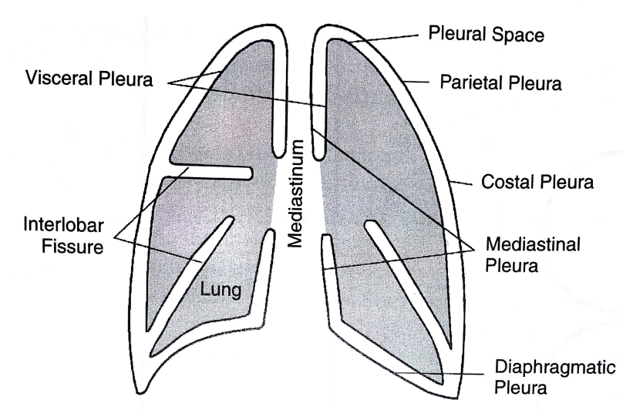
Pleural anatomy (1)
The pleura consists of two membranes:
- Visceral pleura
- Parietal pleura
Pleural space: the potential space between parietal and visceral pleura
Contains tiny amount of pleural fluid ~0.3 ml/kg

Slide 5
Pleural Anatomy (2)
Pleura lines not only the surfaces of the lung that are in direct contact with the chest wall but also the diaphragmatic and mediastinal borders of the lung.
Visceral pleura also separates the lobes of the lung from each other.
Two apposing visceral surfaces form fissures.
Lining of the pleurae formed by mesothelial cells.

Slide 6
Pleural Anatomy (3)
Below the mesothelial lining is the lining of thin connective tissue which has BVs and lymphatics.
The BVs and lymphatics are important in dynamics of pleural fluid formation.
On the parietal pleura there are openings in the mesothelial cells called as stomata (only on parietal pleura).
These stomata leads to lymphatic channels, alowing passageway for liquid from pleural space to the lymphatic system.

Slide 7
Pleural Anatomy (4)
Sensory nerve endings are there in the parietal and diaphragmatic pleura.
BVs supplying parietal pleural surface originate from the systemic arterial circulation-primarily Inter Costal Artery.
Venous blood from the parietal pleura drains to systemic venous system.

Slide 8
Pleural Anatomy (5)
Visceral pleura is also supplied primarily by systemic arteries, specifically branches of bronchial arterial circulation, but the venous drainage is in to pulmonary venous system.
The Lym. Ves. that drain the pleural surfaces transport their fluid contents to different lymph nodes.
Ultimately the fluid is transported to the right lymphatic or thoracic ducts, which empty in to the systemic venous circulation

Slide 9
PHYSIOLOGY (1)
Pleural space normally contains small amount of fluid (10 ml).
As per recent concept, formation of fluid is ongoing primarily from the parietal pleural surface, and fluid is resorbed through the stomata into the lymphatic channels of the parietal pleura.
Normally rate of formation = absorption.

Slide 10
PHYSIOLOGY (2)
Pleural fluid is the ultra filtrate from the pleural capillaries.
There are counteracting forces which are responsible for transport of fluid, these are Hydrostatic pressure –P, and Colloid oncotic pressure-COP.
‘P’ promotes movement of fluid out of the capillaries and COP prohibits the movement from the capillaries.

Slide 11
PHYSIOLOGY (3)
Starlings equation can be applied to parietal pleura:
P_{c} =30 cm H₂ O,
P_{is} (mean intrapleural pressure)= -5 cm H₂ O,
COP_{c} =32 cm H₂ O,
COP_{is} =6 cm H₂ O,
σ=1, K=1
Fluid movement at parietal pleura = [30-(-5)]-1(32-6)=9 cm H₂ O
Fluid movement = K[(P_{c} –P_{is} ) – σ(COP_{c} –COP_{is} )]
K=filtration coefficient (a function of the permeability of the pleural surface), P= hydrostatic press, COP= colloid oncotic press, σ= measure of capillary permeabity to protein (called the reflection coeff) and subscripts “c” and “is” refers to capillary and pericapillary interstitial space.

Slide 12
PATHOGENESIS(1)
A change in the magnitude of any of the factors in the Starling equation can cause sufficient imbalance in the pleural fluid dynamics resulting in pleural fluid accumulation.

Slide 13
PATHOGENESIS (2)
There are mainly two categories of change
1. Alteration of the permeability (i.e. change in the filtration coeff K)& permeability to protein σ-reflection coeff.
2. Alteration in the driving pressure, encompassing a change in the P or COP of the parietal or visceral pleura without any change in the permeability.
Pleura becomes more permeable to the fluid and Large mol weight components of blood.
Accumulated fluid ⇒ Transudative
Changes seen most commonly in CHF or hypoproteinemia.
Accumulated fluid ⇒ Exudative
Changes seen most commonly in inflammatory and neoplastic diseases

Slide 14
PATHOGENESIS (3)
There is also a third mechanism sometimes which is different from the these and fluid originates in the peritoneum as ascitic fluid and travels to the pleural space primarily via small diaphragmatic defects perhaps also by diaphragmatic lymphatics.
The fact is intrapleural pressure is more negative than intraperitoneal pressure which favors movement through these defects.
Interference with resorptive process like blockage of lymphatic drainage as occurs when tumor cells invade the lymphatic channels or the draining LN.

Slide 15
ETIOLOGY
Major causes of Pleural effusion
Transudate:
Increased hydrostatic pressure; “overflow
of liquid from the lung interstitium-CHF
Decreased plasma oncotic pressure
Nephrotic syndrome
Movement of transudative ascitic fluid through DP

Slide 16
EXUDATE
Inflammatory
Infection (TB, bacterial pneumonia)
Pulmonary embolus
Connective tissue dis (lupus, RA)
Adjacent to subdiaphragmatic dis (pancreatitis,
subphrenic abscess)
Malignant
Others
benign ovarian tumors (Meig’s syndrome)
asbestos exposure
hypothyroidism

Slide 17
CLINICAL FEATURES
SYMPTOMS:
Symptoms depend on the size of effusion and nature of underlying process.
Inflammatory process present with pleuritic chest pain.
When effusion is large pt present with dyspnea.
Small or moderate size effusion with otherwise normal lung does not have dyspnea.
When pl fl has an inflammatory nature or is infected fever is commonly present.

Slide 18
A h/o cardiac, renal or liver impairment can suggest transudative effusion.
Old age, wt. loss, and a h/o smoking point towards MPE.
Recent leg swelling or DVT may result in effusion related to PE.
Trauma may result in hemothorax or chylotorax.
PCIS should be suspected in cases of fever, dyspnea and pleuritic chest pain up to 03 wks following cardiac surgery.
History and findings s/o CTD and related long term medications suggest that as possible eitiology.

Slide 19
CLINICAL FEATURES
PHYSICAL EXAMINATION:
Movement will be diminished, fullness of the intercostal space, Trail sign may be +ve on opposite side.
Trachea, apex beat may be shifted depending on the amount of fluid. Vocal fremitus –nt.
Region overlying fluid is dull.
Delayed shifting dullnessmay be present. Absent in massive and loculated effusion.
Breathsounds-decreased, egophony at the upper level, frictional rub.

Slide 20
CLINICAL FEATURES
Symptoms depend on the size of effusion and nature of underlying process.
Inflammatory process present with pleuritic chest pain.
When effusion is large pt present with dyspnea.
Small or moderate size effusion with otherwise normal lung does not have dyspnea.
When pl fl has an inflammatory nature or is infected fever is commonly present.
Physical examination, region overlying fluid is dull, breathsounds-decreased, egophony at the upper level, frictional rub.

Slide 21
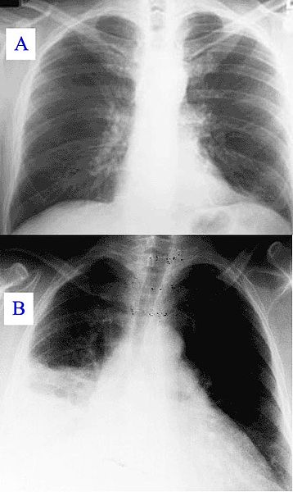
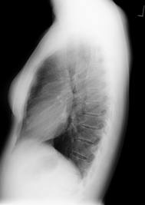
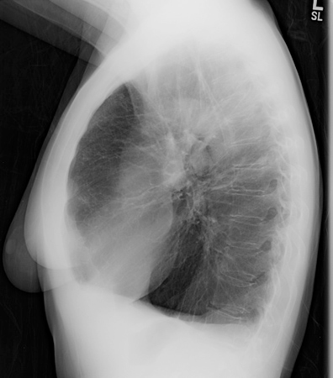
INVESTIGATIONS: Imaging Studies
Chest X-ray

Slide 22
Chest X-ray
Classical homogenous opacity with curved upper border, i.e. the Ellis S-shaped curve.

Slide 23
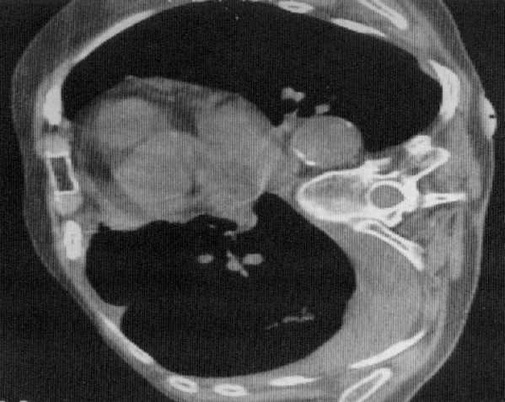

Slide 24
Ultrasonography thorax
This helps in detecting even the small amount of fluid.
USG is helpful in cases of loculated PE for confirmation of the diagnosis and for making a site for aspiration.
Helps in differentiating fluid filled and solid lesions.
Also helps in detecting subpulmonic effusion from sub diaphragmatic collection.

Slide 25
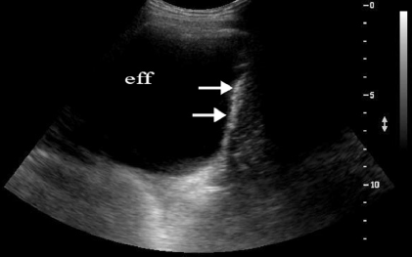

Slide 26
CT thorax
Used to assess the complex situation in which anatomy is not fully assessed by plain radiography or USG.
Helps in selecting drainage site in empyema.
Differentiates loculated empyema from lung abscess.

Slide 27
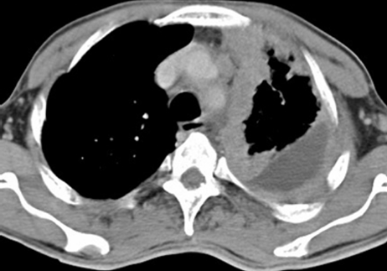

Slide 28
PET
F-18 fluorodeoxyglucose positron emission tomography seems promising for differentiating b/w benign and malignant pleural disease with a sensitivity of 97% and specificity of 88.5%.
Limitation are inflammatory processes like TB and rheumatoid effusion which may also be positive.

Slide 29
Thoracentesis and cytobiochemical fluid analysis
Indication
Larger than 1 cm on lateral decuibitus or USG
Not in b/l as strong suspect for transudate, unless there are atypical features or patient fails ro respond
Diagnostic tap for biochemical, cytological and microbiological exam is needed for correct dx.
Differentiation b/w transudate and exudate is crucial before further tests are undertaken.

Slide 30
Exudate Vs Transudate
Light’s criteria for exudative PE
Pleural fluid protein divided by serum protein> 0.5
Pleural fluid LDH divided by serum LDH >0.6
Pleural fluid LDH more than 2/3rd the upper limit of normal serum LDH
Sensitivity-98%, specificity-74%
A total nucleated cell count of >1000/ml is exudate.

Slide 31
Cytobiochemical
When count >10000/ml-> Parapneumonic
Lymphocytosis is common in TB and malignancy.
In normal state pleural fluid glucose is equal to peripheral glucose.
A low glucose concentration is defined as ratio of pleural fluid glucose to serum glucose <0.5 and is seen with exudative pleural effusion secondary to empyema, rheumatoid disease, Lupus, malignacy and esophageal rupture.
Increase pl. fl. Amylase seen in pancreatic disease, esophageal rupture and malignancy.
Cytology is diagnostic in 60% cases approx.

Slide 32
Percutaneous pleural biopsy
Helps differentiating granulomatous and malignant disease.
Done in undiagnosed pleural effusion.
Usually done to investigate the etiology of exudative pleural effusion.
Abrams and Copes needle are used most commonly.
The diagnostic yield varies from study to study and expertise, reported as high as 90% and low as 30%.

Slide 33
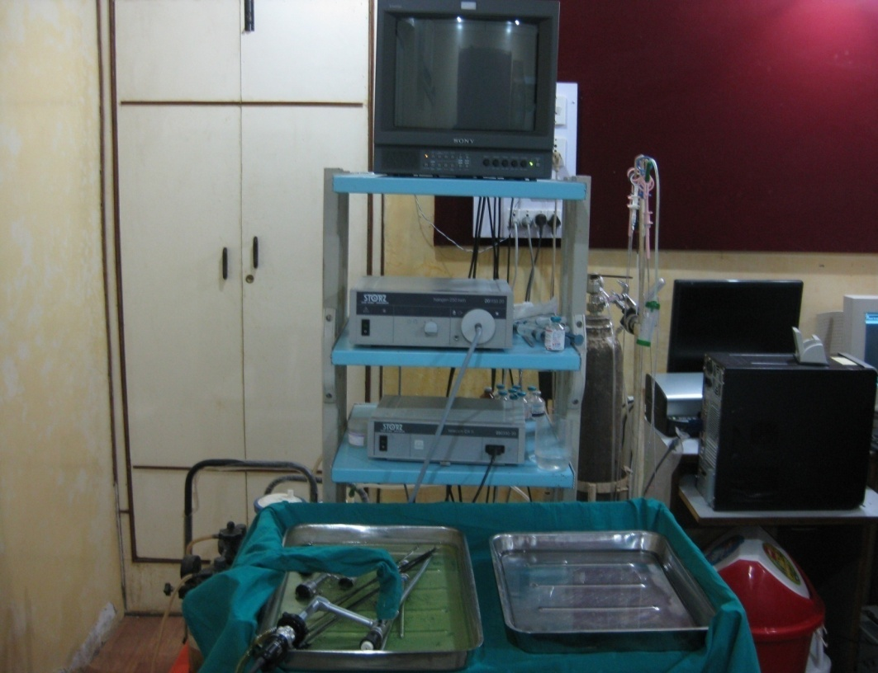
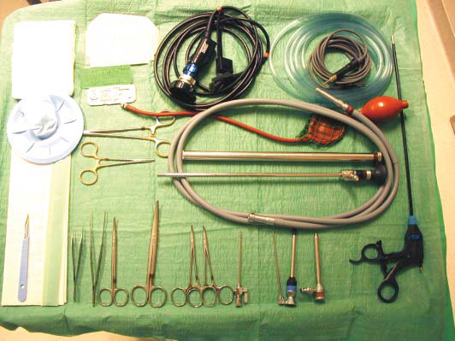
Medical Thoracoscopy
Helps taking large pleural tissue under direct vision.

Slide 34
Visualisation of Pleural space: video

Slide 35
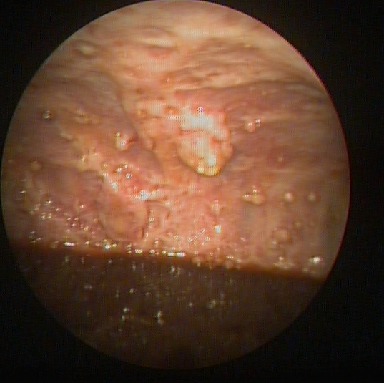
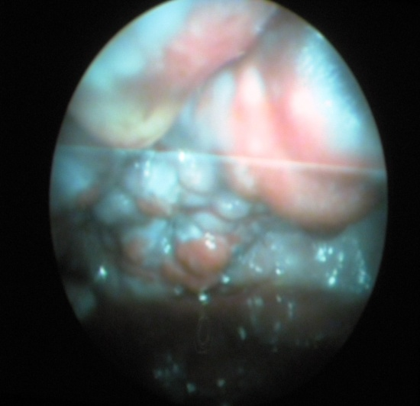
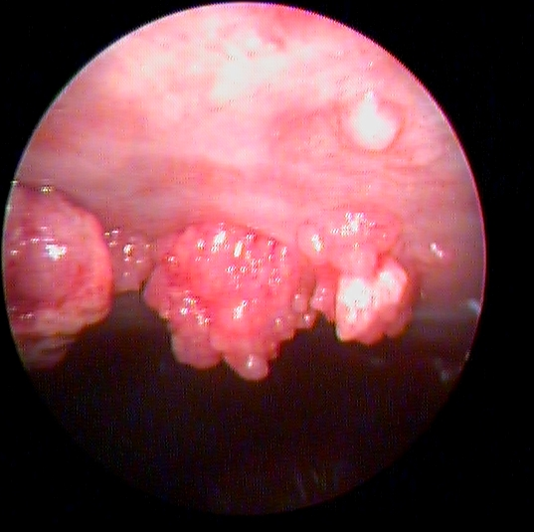
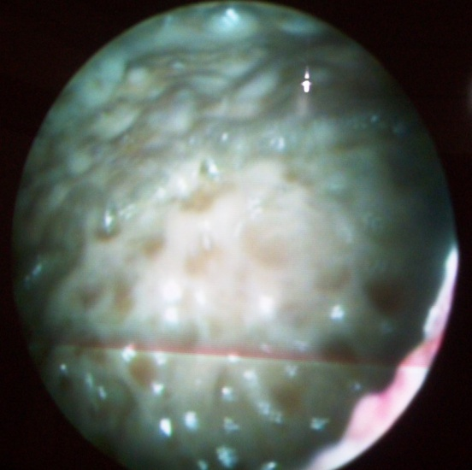
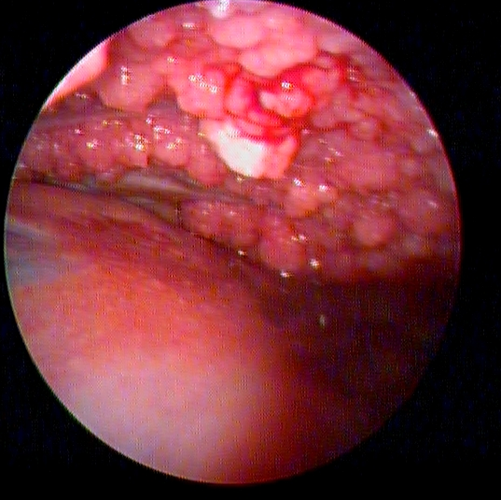
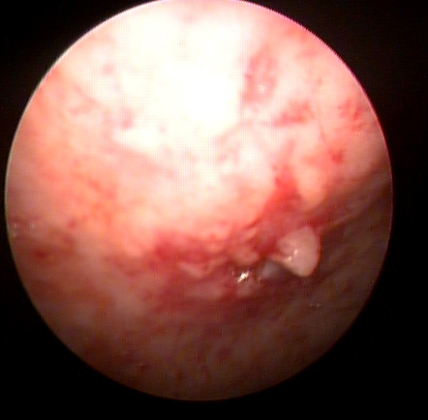
Thoracoscopic Images

Slide 36
Fiberoptic bronchoscopy
Routine FOB is not justified.
Should be done in cases of suspected malignant PE, where there is associated abnormality like mass lesion or collapse.

Slide 37
TREATMENT
Depend on the nature of underlying cause.
Drainage of fluid, pleurodesis and surgical management are the therapeutic options for pleural effusion.

Slide 38
Approach to a case

Slide 40
Case scenario
Case 1: Tubercular Pleural effusion
Case 2: Malignant Pleural effusion

